Slide 1
Welcome to the Data Analysis Level 4 Module 5 training session

Slide 2
Quick introduction from the tutor
Notes:
2 mins
Most important – ask participants to close all the background apps that may be taking up bandwidth – apps like Outlook, Spotify, SharePoint, Dropbox all take up a lot of internet!
1 min
It’s easy to drift off and think about work or other things going around you.
There will be plenty of breaks in the day to check up on work/life/family.
But while you are here with us, don’t be distracted.
Be present.
1 min
You’ll appreciate that we have limited time together to learn some of the finer techniques of data analysis.
Please don’t waste time by being late or disappearing down a black hole.
Please be on time.

Slide 3

Check-in and onboarding
The check-in and onboarding session is from 09:00 to 09:45
The onboarding session will ensure you can log in to the Remote Desktop Environment. Student Success Advisors will be available to assist with any technical issues you may experience
The virtual class will formally begin at 10:00
Page 3

Slide 4
Stage 1 Microsoft Teams

Slide 5
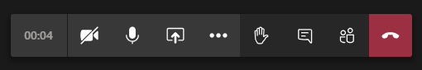
Microsoft Teams
Microphone will show if you’re muted/unmuted
Click here to view the chat
Click here to raise your hand – it will stay up until you click again
Video off

Slide 6
Stage 2 Remote Desktop Environment

Slide 7
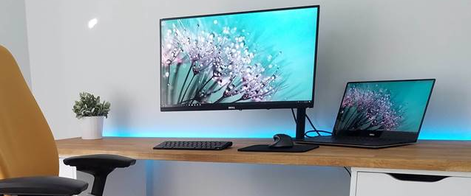

Dual screen – strongly recommended (option 1)
Remote Desktop Environment
MS Teams
Page 7

Slide 8
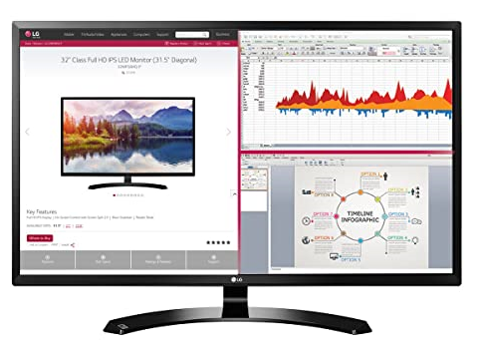
Split screen (option 2)
Remote Desktop Environment
MS
Teams
22–24 inch monitor
Page 8

Slide 9
How to access the remote desktop:​ Step 1
To get started, please go to the login URL for the remote desktop: https://remote.ld.avadolearning.com/rdweb/webclient/index.html
Enter the username and password that has been allocated to you. Please note the following:
Passwords are case sensitive
Make sure no spaces are accidentally added when using cut & paste

Slide 10
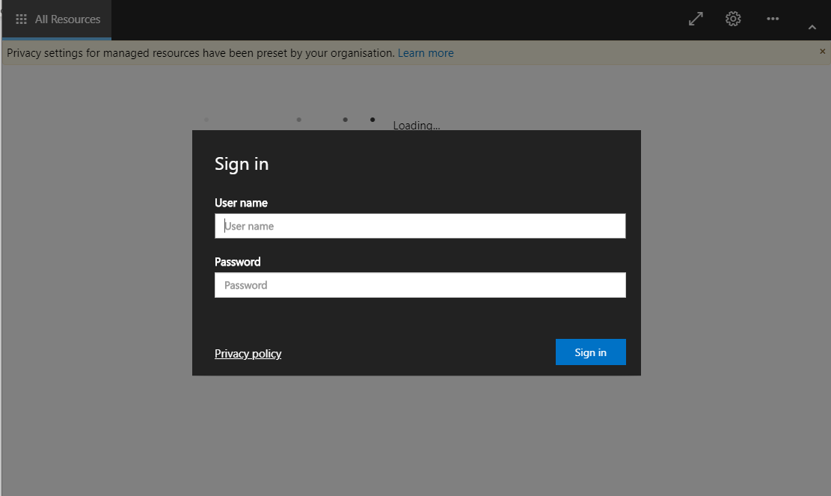
How to access the remote desktop:​ Step 2
username
password

Slide 11
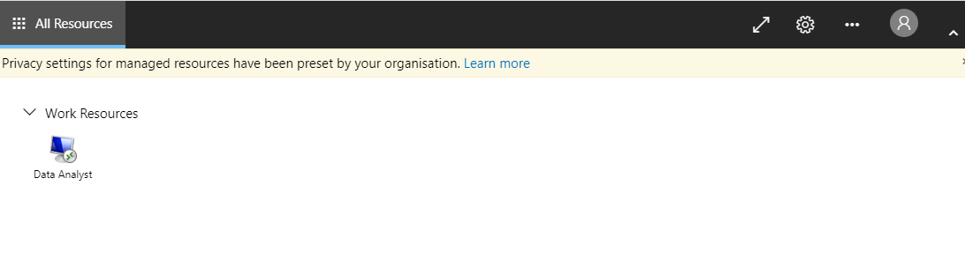
How to access the remote desktop:​ Step 3
After entering your username and password correctly, you’ll reach the following screen. Please click on the ‘Data Analyst’ icon.
Click Here

Slide 12
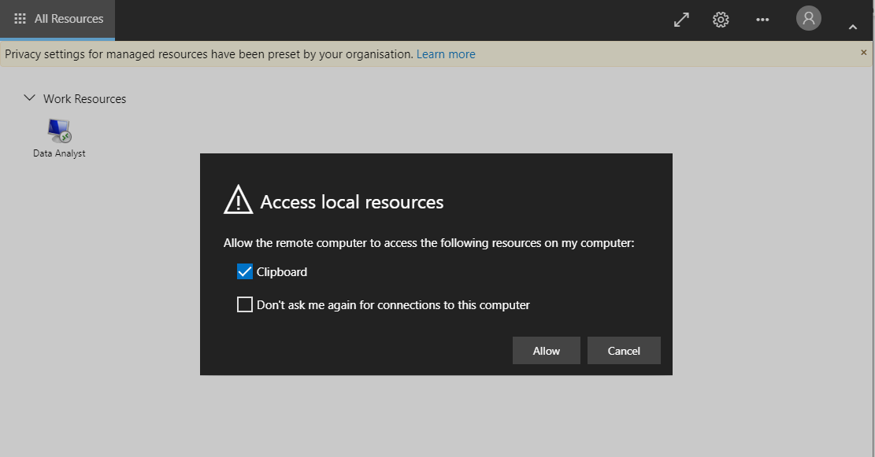
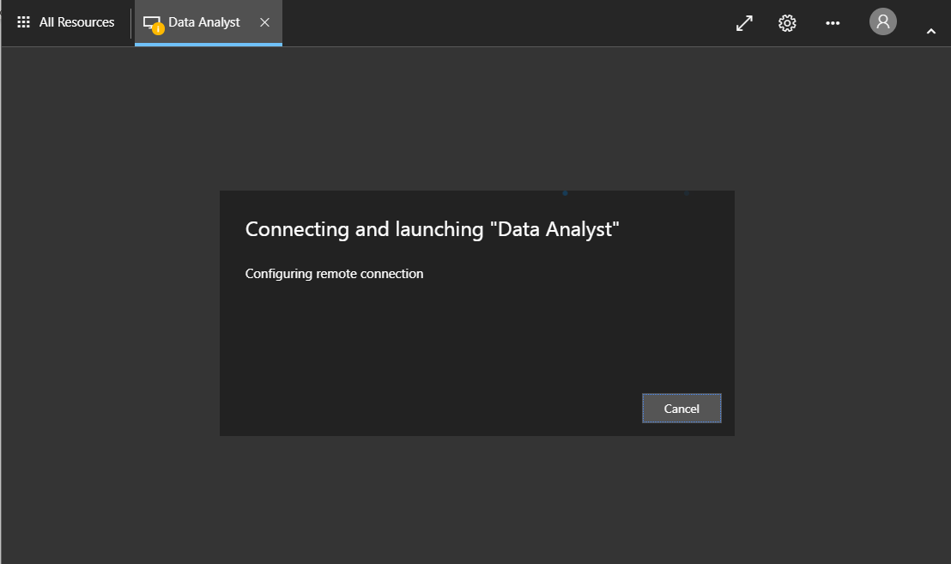
How to access the remote desktop:​ Step 4
1
A notification box will appear as shown in . Please click ‘Allow’.
The Remote Desktop Environment is now connecting, and you may see screen for a few moments as it loads.
2
1
2

Slide 13
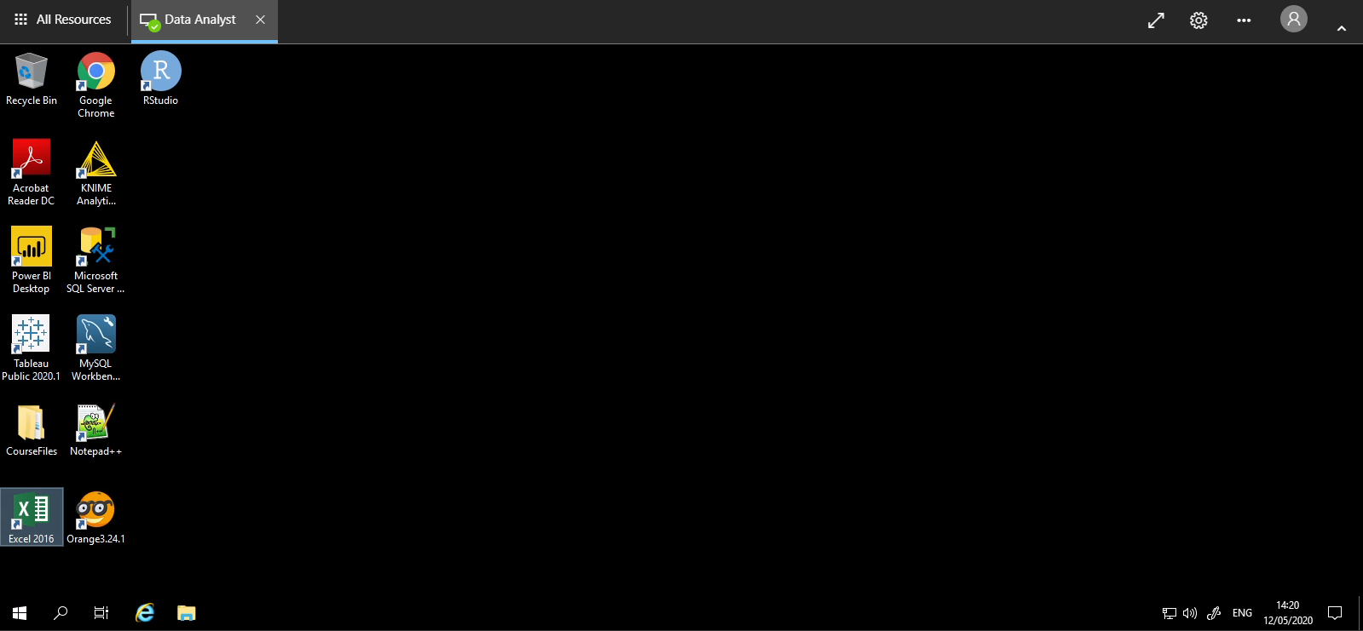
Congratulations, you now have access to the remote desktop!

Slide 14
Stage 3 RDE exploration

Slide 15
Explore the course files

Slide 16
Stage 4 Introduction

Slide 17
Housekeeping
Course hours are 09:00 to 17:00
Please be on time
We'll break for lunch at around 12:30
Attendance will be taken in class at 09:00 and after lunch at 13:30
Keep your mic muted at all times unless you're asking a question
Close all other background apps that may be taking up bandwidth
Health and safety
Page 17

Slide 18

Briefly introduce yourself
Name
Company
Work location
Your role and how analytics relates to it
Analytics expertise
Page 18
Notes:
[Source image at a later date]

Slide 19

Course overview
The main aims of this course are:
To equip you with the right tools and information, so that you're able to offer professional, high-level data analysis and support
To explore a range of concepts, approaches and techniques that are applicable to data analysis
Page 19
Notes:
[Source image at a later date]

Slide 20



Daily agenda
Module 5: Day 1
Introduction to Microsoft Teams, Virtual Classroom Environment and Avado Campus
Python for data science
- Arithmetic and logical operators
- Variables and built-in Functions
- Data types: lists, tuples, sets, dict, string
- Python if/else conditions
- Python loops: for loop and while loop
- Python open function and with open function
Page 20

Slide 21
Daily agenda
Module 5: Day 2
Advance Python for data science
- Exploring NumPy and Pandas Libraries
- Exploring data mining techniques
Module 5: Day 3 – Fusion Day
Page 21

Slide 22
Data Analyst Level 4 – programme overview
Module 1
Data analysis, architecture, and data cleansing
Module 2
Data analysis and visualisation techniques
Module 3
Database design and reporting
Module 4
Data analysis and forecasting with R
Module 5
Data analysis and forecasting with Python
Key
Online learning
Virtual lab
Fusion day
10 hrs
14 hrs
7.5 hrs
10 hrs
14 hrs
7.5 hrs
10 hrs
14 hrs
7.5 hrs
10 hrs
14 hrs
7.5 hrs
10 hrs
14 hrs
7.5 hrs
Page 22

Slide 23

Two optional examinations
BCS Level 4 Certificate in Data Analysis Tools (KM1 Assessment)
BCS Level 4 Diploma in Data Analysis Concepts (KM2 Assessment)
Page 23
Notes:
[Source image at a later date]

Slide 24

Overview of BCS L4 Certificate in Data Analysis Tools (KM1 Assessment)
Assessment for KM1 will be done by examination
Exam format:
One hour duration
Multiple-choice questions
40 questions in total
The pass mark is 26/40 (65%)
Closed-book examination (no materials allowed)
Online examination using a remote proctor
You must book your exam within seven days of receiving your training
You’ll receive an email from Arch Scheduling Team on the first day of the study session, providing further instructions and guidance on the BCS online examination booking process
Page 24

Slide 25

Overview of BCS L4 Diploma in Data Analysis Concepts (KM2 Assessment)
Assessment for KM2 will be done by examination
Exam format:
One hour duration
Multiple-choice questions
40 questions in total
The pass mark is 26/40 (65%)
Closed-book examination (no materials allowed)
Online examination using a remote proctor
You must book your exam within seven days of receiving your training
You’ll receive an email from Arch Scheduling Team on the first day of the study session, providing further instructions and guidance on the BCS online examination booking process
Page 25

Slide 26
Questions?
Notes:
Any questions?

Slide 27

Stage 5 Lecture begins

Slide 28
Thank you
careers@archapprentices.co.uk
https://www.avadolearning.com/arch-apprenticeships/

